Slide 1

DBB405 SPEAKING IN A FOREIGN LANGUAGE 2024-2025 FALL SEMESTER
Dr. Arş. Gör. Kübra KARACA
kkaraca@ankara.edu.tr

Slide 2
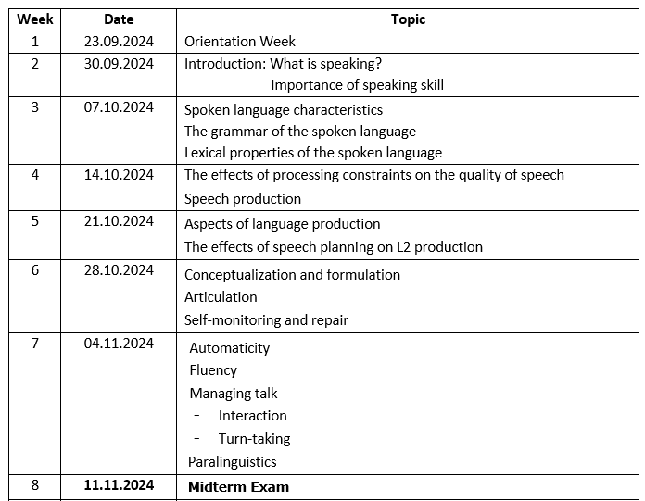
2024-2025 FALL SEMESTER COURSE SYLLABUS

Slide 3
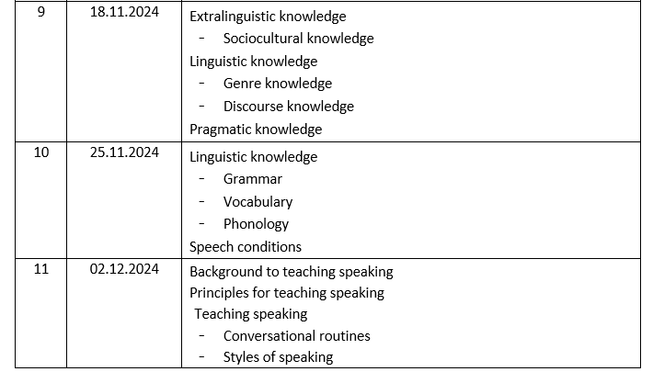
2024-2025 FALL SEMESTER COURSE SYLLABUS

Slide 4
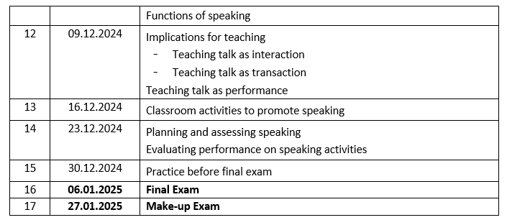
2024-2025 FALL SEMESTER COURSE SYLLABUS

Slide 5
2024-2025 FALL SEMESTER COURSE SYLLABUS
Grading:
%40 Mid-Term Exam (additional homeworks may be added to the mid-term exam)
%60 Final Exam (additional homeworks may be added to the final exam)
Dersin grup linki:
classroom.google.com / gruba katılım kodu: hpum6dp

Slide 6
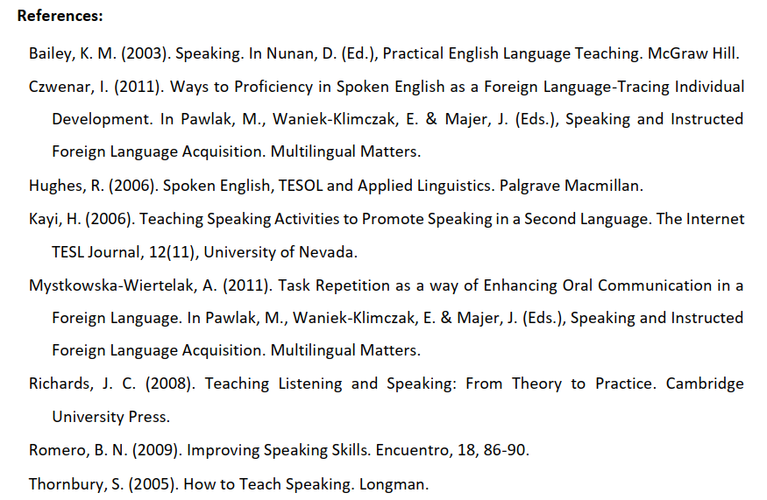
2024-2025 FALL SEMESTER COURSE SYLLABUS

Slide 7

MAIN BOOK OF THE COURSE

Slide 8

ADDITIONAL RESOURCE

Slide 9
CONTACT INFORMATION
Instructor: Dr. Res. Asst. Kübra KARACA
E-mail: kkaraca@ankara.edu.tr
Phone: +(90) 312 310 32 80 \ 1609

